Slide 1

Cloud Computing

Slide 2


What is Cloud Computing
APPLICATION & DATA
SOFTWARE
SERVERS & STORAGE
NETWORK

Slide 3
What is Cloud Computing
allows us to create, configure, and customize applications via an internet
allows us to store, manage, and access data online rather than local drives

Slide 4
What can be done using Cloud Computing
Developing new applications and services
Storage, back up, and recovery of data
Hosting blogs and websites
Delivery of software on demand
Analysis of data
Streaming videos and audios
etc ….

Slide 5
History of Cloud Computing
1961, John MacCharty suggested in a speech at MIT that computing can be sold like a utility, just like a water or electricity
1999, Salesforce.com
2002, Amazon AWS
2009, Google Apps
2009, Microsoft Azure
Oracle and HP have all joined the game
Today, cloud computing has become mainstream.

Slide 6
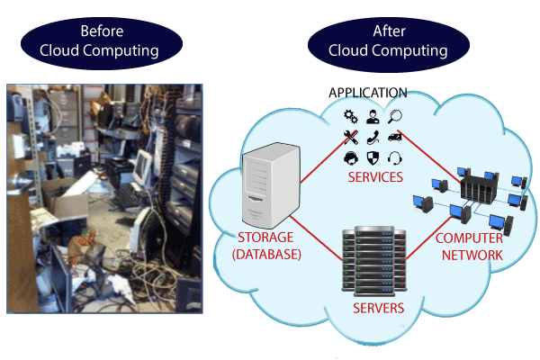
Why Cloud Computing?

Slide 7
Why Cloud Computing?
Traditional Method
Cloud Computing
Server Room | database server, mail server, networking, firewalls, routers, modem, switches, the maintenance engineers etc..
reduce the IT infrastructure cost
spend lots of money

Slide 8
Characteristics of Cloud Computing
Elasticity | Computational capacity increases and decreases automatically based on requirement
Services in the pay-per-use mode | APIs are provided to the users so that they can access services on the cloud by using these APIs and pay the charges as per the usage of services
Agility | It shares resources among users and works very fast
High availability and reliability | Availability of servers is high and more reliable because the chances of infrastructure failure are minimum
High Scalability | Cloud offers "on-demand" provisioning of resources on a large scale, without having engineers for peak loads

Slide 9
Characteristics of Cloud Computing
Multi-Sharing | Multiple users and applications can work more efficiently with cost reductions by sharing common infrastructure.
Device and Location Independence | As infrastructure is off-site and accessed via the Internet, users can connect from anywhere.
Maintenance | Maintenance of applications is easier, since they do not need to be installed on each user's computer and can be accessed from different places
Low Cost | IT company need not to set its own infrastructure and pay-as-per usage of resources.

Slide 10
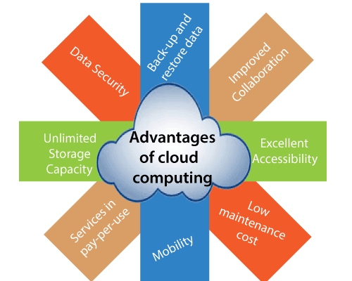
Advantages of Cloud Computing

Slide 11
Advantages of Cloud Computing
Back-up and restore data | Once the data is stored in the cloud, it is easier to get back-up and restore that data using the cloud.
Improved collaboration | Cloud applications improve collaboration by allowing groups of people to quickly and easily share information in the cloud via shared storage.
Excellent accessibility | Cloud allows us to quickly and easily access store information anywhere, anytime in the whole world, using an internet connection
Low maintenance cost | Cloud computing reduces both hardware and software maintenance costs for organizations.

Slide 12
Advantages of Cloud Computing
Mobility | Cloud computing allows us to easily access all cloud data via mobile.
pay-per-use model | Cloud computing offers APIs to the users for access services on the cloud and pays the charges as per the usage of service.
Unlimited storage capacity | Cloud offers us a huge amount of storing capacity for storing our important data in one place.
Data security | Cloud offers many advanced features related to security and ensures that data is securely stored and handled.

Slide 13
Disadvantages of Cloud Computing
Internet | If you do not have good internet connectivity, you cannot access these data. However, we have no any other way to access data from the cloud.
Vendor lock-in | Organizations may face problems when transferring their services from one vendor to another. As different vendors provide different platforms, that can cause difficulty moving from one cloud to another.
Limited Control | cloud infrastructure is completely owned, managed, and monitored by the service provider, so the cloud users have less control over the function and execution of services within a cloud infrastructure.
Security | While sending the data on the cloud, there may be a chance that your organization’s sensitive information is hacked by Hackers.

Slide 14
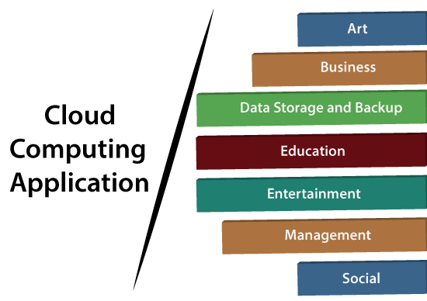
Cloud Computing Applications

Slide 15
Cloud Computing Applications
Art Application
Vistaprint
Moo
Adobe Creative Cloud

Slide 16
Cloud Computing Applications
Salesforce
Business Application
MailChimp
Chatter
Paypal
Bitrix24
Slack
Quickbooks

Slide 17
Cloud Computing Applications
Box.com
Data Storage & backup Application
Google G Suite
Joukuu
Mozy

Slide 18
Cloud Computing Applications
Education Application
Google Apps
AWS

Slide 19
Cloud Computing Applications
Entertainment Application
Online games
Video Conferencing

Slide 20
Cloud Computing Applications
Management Application
Toggl
Evernote
Outright
GoToMeeting

Slide 21
Cloud Computing Applications
Social Application
Facebook
Twitter
Yammer
LinkedIn

Slide 22
Cloud Computing
Thank You

